Slide 2
Fun With English
Language of Instruction: English
The children will learn songs, rhymes, story telling, art and painting in an English speaking environment. To improve the effectiveness of the class, children may be reassigned to classes of different age groups depending on their English proficiency. Each class is limited to 15 children.
Code | Age | Day | Time | Fee |  | Class Dates (3 weeks)
E1 | 3 to 6 | Monday to Friday | 9:30 a.m.- 12:00 noon (A.M Session) | $5500- (for Think International students only and before the 12th May) | $6000 (for Others) | 4 August (Mon) to 22 August (Fri)
E2 |  |  | 1:00 p.m.- 3:30 p.m. (P.M. Session)
Project fun for
Whole day children
Language of Instruction: English + Putonghua
Our Kindergarten provides a whole day summer program. By using a project approach, children can build up their English communication skills. It also allows them to develop their problem solving skills and be creative. Most importantly, the children enjoy the project approach and have fun learning many skills this summer! (For our UN, Bunnies, Deer, LK & UK students only)
Code | Language | Age | Day | Time | Fee | Class Dates (3 weeks)
W1 | Half day in English + Half day in Putonghua | 3 to 6 | Monday to Friday | 9:30 a.m. - 3:30 p.m. | $9675- (for Think International students only and before 12th May) | 4 August (Mon) to 22 August (Fri)

Slide 3
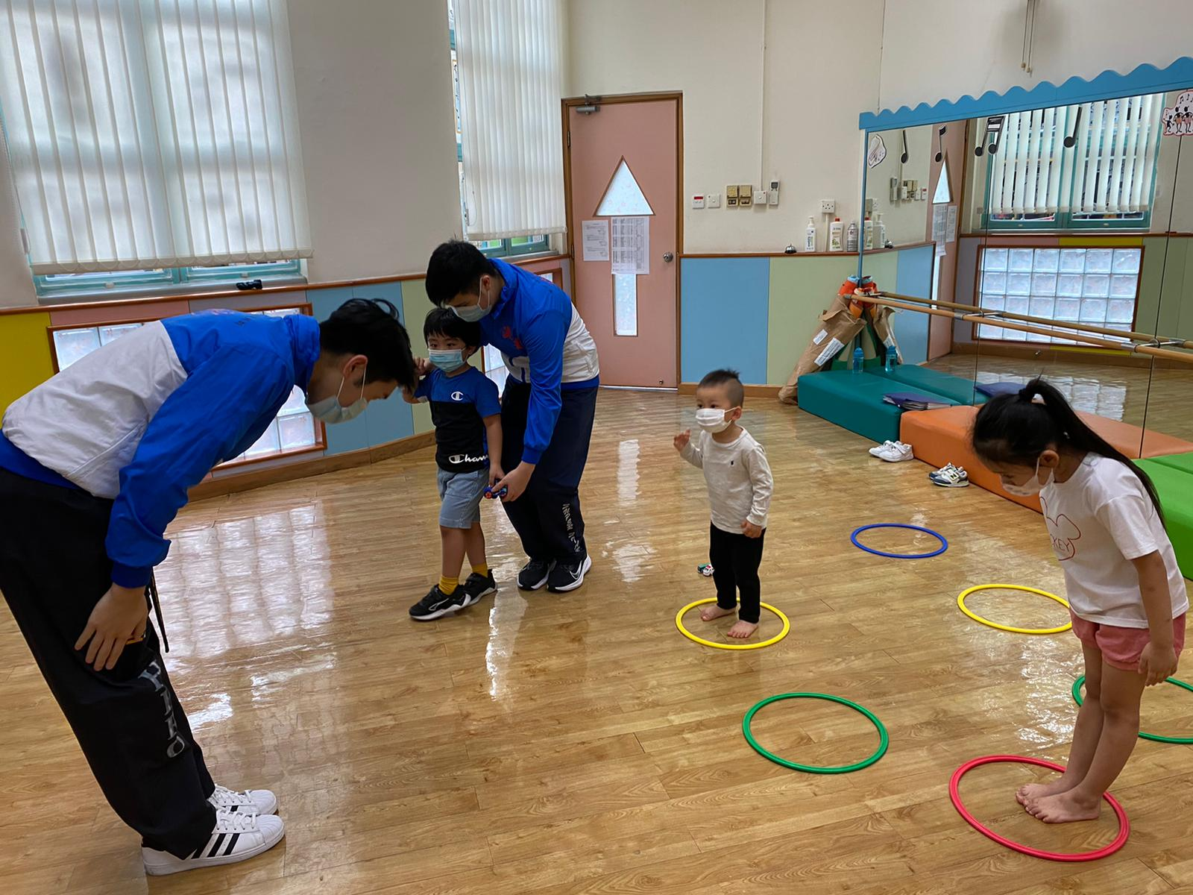
Fun with Taekwondo
Language of Instruction:
Cantonese supplemented with Korean
This Taekwondo program aims at enriching children with the spirit of Taekwondo and to providing a strong foundation for character building. Children are encouraged to progress through the belt system: white, yellow, green, blue, red and black so that they can mature physically and spiritually. Examinations will be organized for the children around once per year (subject to the child’s progress). This program is well-structured and well-recognized, so that the children can bridge up to other Taekwondo classes in the future even when they graduate from our Kindergarten.
Code | Age | Day | Time | Fee | Class Dates (4 lessons)
T1 | 2 to 6 | Mon | 3:30pm-4:30pm | $960- | 4, 11, 18, 25 August

Slide 4
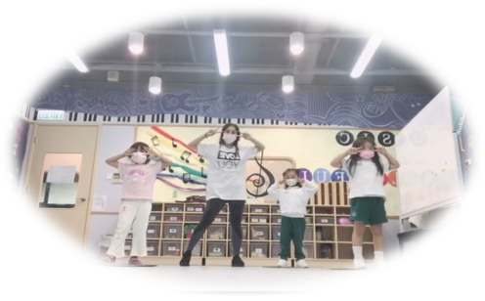
Fun with Hip Hop
Language of Instruction: Cantonese
Hip Hop dance is corporates old and new dance moves and styles like break dancing, popping, crumping and even traditional jazz moves. A large part of hip hop dance is creativity and improvisation and just letting the music move you. This is a great way to encourage creativity and expression through dance classes for children.
Code | Age | Day | Time | Fee | Class Dates ( 4 lessons)
H1 | 3 to 6 | Tue | 3:30pm-4:15pm | $960- | 5, 12, 19, 26 August

Slide 5
Fun with Art
Language of Instruction: Cantonese
Unleash your child's creativity in a vibrant world of colors! From pencils to crayons, brushes to watercolors, a variety of tools awaits to help children bring their imaginations to life. Engaging activities like cutting, sticking, folding, drawing, and painting not only foster our techniques but also improve the coordination of their hands and eyes. (All art supplies included for endless artistic exploration!)
Code | Age | Day | Time | Fee | Class Dates (3 lessons)
A1 | 3 to 5 | Thursday | 12:00 noon – 12: 45 pm | $660- | 14, 21, 28 August
A2 | 3 to 5 | Thursday | 3:30 pm – 4:15 pm | $660- | 14, 21, 28 August

Slide 6
Code | Age | Day | Time | Fee | Class Dates ( 6 lessons)
C1 | 3 to 6 | Tue & Thur | 3:30 p.m. – 4: 15 pm | $1320- | 12, 14, 19, 21, 26, 28 Aug
Code | Age | Day | Time | Fee | Class Dates ( 6 lessons)
CK1 | 3 to 6 | Tue & Fri | 12:00 noon – 12: 45 pm | $1320- | 12, 15, 19, 22, 26, 29 Aug
CK2 | 3 to 6 | Tue & Fri | 3:30 pm – 4:15 pm | $1320- | 12, 15, 19, 22, 26, 29 Aug

Slide 7
Fun with 3W / 5W
Language of Instruction: Cantonese
Language skills are fundamental for early development and essential for primary interviews. What better way to enhance them than through the magic of storytelling? Children will explore colourful picture books, create their own tales using fun props, and act out silly characters. Through interactive story circles, children will not only prepare for primary interviews but also cultivate confidence and endless creativity.
Code | Age | Day | Time | Fee | Class Dates (6 lessons)
3 W (LN-UN) 5 W (LK-UK) | 3 to 5 | Mon & Wed | 3:30 pm – 4:15 pm | $1320- | 11, 13, 18, 20, 25, 27 Aug

Slide 8
Fun with STEAM
Language of Instruction: Cantonese
Let’s play and learn with STEAM this summer! Through fun science experiments, creative building blocks, colourful art projects, and exciting nature discovery, little hands will explore, create, and giggle while learning new things every day! Watch as your child discovers floating and sinking, builds mini robots, and creates rainbow explosions—all while making new friends!
Code | Age | Day | Time | Fee | Class Dates (6 lessons)
S1 | 3 to 5 | Tuesday & Thursday | 3:30 pm – 4:15 pm | $1320- | 12, 14, 19, 21, 26, 28 Aug

Slide 9
Think International Educational Services Limited
Summer Fun 2025
Enrolment Form (August) –Nam Cheong
Enrolment and Programme Regulations
All fees paid are non-refundable, and no make up class for absentee.
For when Typhoon No. 3 and Red Rainstorms or higher are hoisted, the lesson will be cancelled without compensation.
If the Red / Black rainstorm signal is in effect while the kindergarten is in session, children will continue their session at school
Children that have fever or not feeling well are encouraged to stay home and rest.
Shop G26 V Walk G/F.,
28 Sham Mong Road, Shamshuipo, Kln.
九龍深水埗深旺道28號V Walk 地下G-26室
(南昌西鐵站)
Inquiry 查詢電話 : 2157-2111
Fax 傳真︰2157-2000

Slide 10
Think International Educational Services Limited
Summer Fun 2025
Enrolment Form (August) –Nam Cheong
Please submit the filled Enrolment Form and deposit slip to our school office. Payment transfer can be done by i) FPS telephone no. 57208383 ii) or direct deposit to the A/C No. 015-18668-001187 (Bank of East Asia Current A/C) with A/C Name: Think International Kindergarten. We will issue an official receipt once the enrolment is confirmed. (No cash or cheque, please) (Please ☑ )
Name of Child : |  |  | (Eng) |  |  |  | (Chi)
Birthday (D/M/Y): |  |  |  |  |  |  | Sex:
Parent’s Tel. No.: |  |  | (Mobile) |  |  |  | (Home)
Home Address:
Current THINK student ?
 | □ | Yes |  | Class Attending : LN__ /UN___/LK___/UK___
 | □ | No |  | School Attending: ___________________________________
Cheque Number : ___________________ Amount : $__________________
Programmes to enroll (Please ☑ )
Fun with English (Mon to Fri) |  |  | E1 A.M |  | E2 P.M | E2 P.M. (LN & UN) E2 P.M. (LK & UK) |  | E2 P.M. (LN & UN) E2 P.M. (LK & UK) | $6300 for Think students | $5500- for Think students
 |  |  |  |  |  |  |  |  | $6800 for Others | $6000- for Others
Project Fun for Whole day children (Mon to Fri) |  |  | □ W1 $9675- (English + Putonghua) (For UN, LK, UK student only)
My child needs school bus service for E1, E2, W1 and current THINK students only. Name of Route Station : _______________________ □ One-Way to school / □ One-way from School / □ Round trip *** The Bus fee will remain the same price as currently. *** The school will try to schedule a possible route for your area and we will contact you individually. *** We apologize for any inconvenience if we can’t schedule your preferred area. ******************************************************************************
Fun with Taekwondo (Monday) |  |  |  |  |  |  |  | □ T1 $960-
Fun with Hip Hop (Tuesday) |  |  |  |  |  |  |  | □ H1 $960-
Fun with Chinese Writing (Tuesday & Thursday) |  |  |  |  |  |  |  | □ C1 $1320-
Fun with Art (Thursday) |  |  |  |  |  |  |  | □ A1 $660- □ A2 $660-
Fun with 3W/5W (Monday & Wednesday) |  |  |  |  |  |  |  | □ 3W $1320- □ 5W $1320-
Fun with Steam (Tuesday & Thursday) |  |  |  |  |  |  |  | □ S1 $1320-
Fun with Cooking (Tuesday & Friday) |  |  |  |  |  |  |  | □ CK1 $1320- □ CK2 $1320-
(Is your child allergic to any materials? No / Yes _______________________________________)

